Slide 1
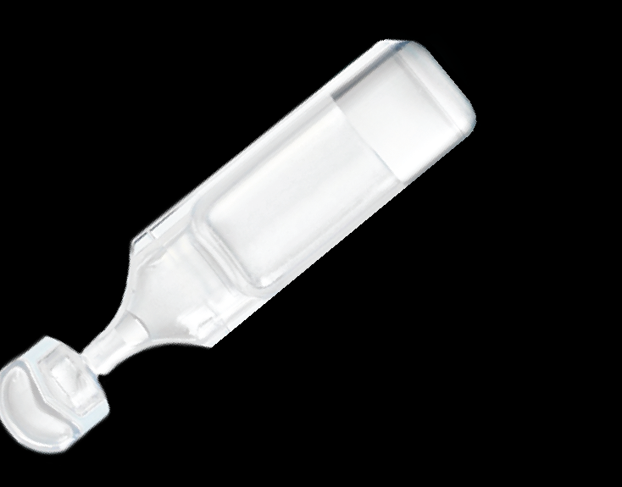

COMPOUNDING, FILL-FINISH OF SINGLE-DOSES USING BLOW-FILL-SEAL TECHNOLOGY
Unither Pharmaceuticals is a Global Pharmaceutical CDMO specialized in single dosage forms to simplify the lives of patients.
Blow-Fill-Seal is a high throughput aseptic manufacturing technology for bottling sterile solutions, suspensions and emulsions
BLOW-FILL-SEAL TECHNOLOGY SPECIFITIES
2 TYPES OF COLLABORATION
Filling volume:
From 0,25 to 10 mL
Different designs Shapes, sizes, resins and colors
Contract Development
& Manufacturing
for strategic outsourcing
Packaging material:
Low Density Polyethylene (LDPE)
Formulation types: Solutions, suspensions, emulsions, proteins and popypeptides
Turnkey products & Dossiers
for licensing-in
Status: Drugs, Medical devices, Cosmetics
Marking options: ink jet printing, label, embossing, hot stamping
DOSSIERS l FOR LICENSING-OUT
FIRST BFS WORLDWIDE LEADER
BFS (Blow-Fill-Seal) | Fill
Borax/Boric acid 1.2%/1.8% | 5 mL
Carboxy Methyl Cellulose 1% | 0.4 mL
Hypertonic saline solution 3% | 5 mL
Hypertonic saline solution 3%, 6%, 7% | 4 mL
Isotonic saline solution 0.9% | 5 mL
Isotonic saline solution 0.9% | 2.5, 5
Multipurpose isotonic 0.9% | 5 mL
Ofloxacin 1.5 mg/0.5ml | 0.5 mL
Sea water | 5 mL
Sodium cromoglicate 2% | 0.3 mL
Capacity: currently 4 Billion SDU / year
5 manufacturing sites:
Amiens (France)
Coutances (France)
Nanjing (China)
Gannat (France)
Rochester (USA)
Unique offer
Worldwide location & Dual sourcing supply
Authorizations
FDA (USA),
EMEA (Europe),
ANVISA (Brazil),
SKFDA (South Korea),
and most of other authorities worldwide
Development & Analytics
BFS dedicated development team
Large expertise
Pilot workshop
OTHER TECHNOLOGIES : Sterile liquids (BFS, Preservative free Multi-dose), Non- sterile liquids (Liquid stick-packs, Bottles, Tubes), Solids & Semi solids (Tablets & capsules, Ovules & suppositories)
CONTACT: contact@unither-pharma.com
WWW.UNITHER-PHARMA.COM

